Slide 1


November 10, 2016
Economic Development Forum

Slide 2

Agenda
8:30 Welcome/Purpose Mark Brace
How is our economy? Dr. Mark Snead
Fort Sill’s Economy Joe Gallagher
9:50 Break
10:00 LEDC Mission, Initiatives and Metrics Phil Kennedy
Reality Check, Thoughts on Econ Dev Dr. Tom Thomas
Moving Forward Mark Brace &
Phil Kennedy
11:45 Lunch

Slide 3
Welcome and Purpose
Mr. Mark Brace
Chairman Lawton Fort Sill Chamber of Commerce and Industry
Board Member Lawton Economic Development Corporation

Slide 4

How’s Our Economy?
Dr. Mark Snead
President and Economist Region Track

Slide 5
Lawton Economic Performance
Key Long-Run Structural Concerns:
Shrinking Federal presence (both military and civilian)
Larger private sector presence (absolute and relative)
Manufacturing downtrend
Population trend

Slide 6
Lawton Economic Performance, cont.
Key Short-Run Cyclical Concerns:
State oil and gas slowdown
Government contraction
Housing prices
Retail market
Population trend
Manufacturing weakness

Slide 7
Structural Changes

Slide 8
Military employment down 3,200 since 2010
Federal Employment - Military
Lawton, OK MSA
Source: Bureau of Economic Analysis and RegionTrack estimates

Slide 9
Civilian employment down 750 jobs since 2010
Federal Employment - Civilian
Lawton, OK MSA
Source: Bureau of Economic Analysis and RegionTrack estimates

Slide 10
Federal jobs down steadily by 4,000 since 2010
Federal Civilian and Military Employment
Lawton, OK MSA
Source: Bureau of Economic Analysis and RegionTrack estimates

Slide 11
Goods-related hiring remains weak both LR and SR
Wage & Salary Employment – Private Goods
Lawton, OK MSA
Source: Bureau of Labor Statistics and RegionTrack estimates

Slide 12
Manufacturing is primary driver behind goods cycle
Wage & Salary Employment – Private Goods vs. Manufacturing
Lawton, OK MSA
Source: Bureau of Labor Statistics and RegionTrack estimates

Slide 13
Local govt. down 500 jobs since 2010
Wage & Salary Employment – State and Local Government
Lawton, OK MSA
Source: Bureau of Labor Statistics and RegionTrack estimates

Slide 14
Private services sector is carrying the hiring load
Wage & Salary Employment – Private Services
Lawton, OK MSA
Source: Bureau of Labor Statistics and RegionTrack estimates

Slide 15
Transition to a smaller Federal presence continues
Total Employment by Major Source (Wage & Salary + Proprietors)
Lawton, OK MSA
Source: Bureau of Economic Analysis and RegionTrack estimates

Slide 16
75% of all local jobs now outside Federal sector
Total Employment Share by Major Source (Wage & Salary + Proprietors)
Lawton, OK MSA
Source: Bureau of Economic Analysis and RegionTrack estimates

Slide 17
Current Economic Cycle

Slide 18
Lawton rebound slowed by oil and gas pullback
Civilian Nonfarm Wage & Salary Employment
Lawton MSA vs. State of Oklahoma, Indexed at Jan-2010
Source: Bureau of Labor Statistics and RegionTrack estimates

Slide 19
Local jobless rate revised up along with the state
Unemployment Rate (%)
State of Oklahoma and Lawton, OK MSA
Source: Bureau of Labor Statistics and RegionTrack estimates

Slide 20
Lawton began outpacing state hiring in 2015
Civilian Nonfarm Wage & Salary Employment Growth
Lawton MSA vs. State of Oklahoma
Source: Bureau of Labor Statistics and RegionTrack estimates

Slide 21
Total wage growth outpacing the state
Growth in Total Wage and Salary Income (non-military)
State of Oklahoma and Lawton, OK MSA
Source: Bureau of Labor Statistics and RegionTrack estimates

Slide 22
Growth in income per worker also outpacing the state
Growth in Wage and Salary Income per Worker (non-military)
State of Oklahoma and Lawton, OK MSA
Source: Bureau of Labor Statistics and RegionTrack estimates

Slide 23
Personal income growth continues to accelerate
Growth in Total Personal Income
annual percent change
Source: Bureau of Labor Statistics and RegionTrack estimates

Slide 24
Retail Market

Slide 25
Retail sales growth in the middle of the pack
Oklahoma’s 30 Largest City Retail Markets – Taxable Sales ($millions)
Rank | Region | 2015 | 2016 YTD | YTD %Chg | Rank | Region | 2015 | 2016 YTD | YTD%Chg
1 | El Reno | 281.0 | 246.2 | 17.5 | 16 | Yukon | 531.3 | 389.5 | -1.2
2 | Owasso | 788.7 | 603.8 | 4.2 | 17 | Midwest City | 831.1 | 613.9 | -1.6
3 | Tahlequah | 290.0 | 222.6 | 2.1 | 18 | Edmond | 1,711.4 | 1,259.7 | -1.8
4 | Bixby | 292.7 | 224.2 | 1.6 | 19 | Lawton | 1,112.7 | 817.9 | -2.2
5 | Moore | 852.9 | 644.7 | 1.4 | 20 | Duncan | 415.6 | 306.9 | -2.4
6 | Muskogee | 609.1 | 458.3 | 0.6 | 21 | Bartlesville | 552.2 | 403.5 | -2.9
7 | Shawnee | 595.8 | 447.5 | 0.4 | 22 | McAlester | 401.0 | 289.3 | -3.3
8 | Stillwater | 818.3 | 610.7 | 0.2 | 23 | Ardmore | 579.9 | 422.6 | -3.4
9 | Broken Arrow | 1,367.1 | 1,028.9 | 0.1 | 24 | Ponca City | 381.7 | 278.9 | -3.8
10 | Ada | 379.4 | 286.0 | 0.0 | 25 | Norman | 1,923.1 | 1,375.3 | -3.9
11 | Sand Springs | 307.0 | 230.6 | -0.2 | 26 | Oklahoma City | 10,933.1 | 7,907.9 | -3.9
12 | Claremore | 374.1 | 280.1 | -0.3 | 27 | Chickasha | 284.9 | 205.0 | -5.7
13 | Tulsa | 7,683.1 | 5,675.5 | -1.1 | 28 | Enid | 861.5 | 609.4 | -6.9
14 | Sapulpa | 305.4 | 227.4 | -1.2 | 29 | Woodward | 317.6 | 205.7 | -17.0
15 | Durant | 346.7 | 258.3 | -1.2 | 30 | Elk City | 321.8 | 203.5 | -19.2
Source: Oklahoma Tax Commission and RegionTrack 2016 Oklahoma Retail Outlook

Slide 26
Lawton retail growth outpaced state and county in ‘15
Taxable Retail Sales Growth
annual percent change
Source: Bureau of Labor Statistics and RegionTrack estimates

Slide 27
Rebound in share of county sales captured by City
City of Lawton Share of Comanche Co. Taxable Retail Sales
percent share
Source: Oklahoma Tax Commission and RegionTrack 2016 Oklahoma Retail Outlook

Slide 28
Elgin’s recent retail share gains have stabilized
City Share of Comanche Co. Taxable Retail Sales
Source: Oklahoma Tax Commission and RegionTrack 2016 Oklahoma Retail Outlook

Slide 29
No other area cities have made share gains
(Cont.) City Share of Comanche Co. Taxable Retail Sales
Source: Oklahoma Tax Commission and RegionTrack 2016 Oklahoma Retail Outlook

Slide 30
City of Lawton Taxable Sales | Total | %Change | Change
 | Sales | 2013 to | 2013 to
NAICS Industry | 2016 (Ann) | 2016 (Ann) | 2016 (Ann)
Sector 4445--Retail Trade | 676,011,003 | -2.1% | -14,699,366
Sector 72--Accommodation and Food Services | 191,540,922 | 15.1% | 25,116,330
Sector 22--Utilities | 78,166,409 | 0.7% | 522,501
Sector 42--Wholesale Trade | 45,787,740 | -5.7% | -2,760,968
Sector 51--Information | 30,931,199 | 11.9% | 3,295,735
Sector 53--Real Estate and Rental and Leasing | 18,861,998 | 26.3% | 3,930,359
Sector 71--Arts, Entertainment, and Recreation | 11,213,883 | 15.4% | 1,496,778
Sector 81--Other Services (except Public Admin) | 9,575,826 | 4.0% | 371,360
Sector 99--Unclassified | 9,416,250 | 108.5% | 4,899,407
Sector 33--Manufacturing | 8,305,286 | -53.9% | -9,705,439
Sector 54--Professional, Scientific, and Technical Serv | 3,403,662 | 44.5% | 1,048,110
Sector 52--Finance and Insurance | 1,284,664 | -42.1% | -934,808
Sector 4849--Transportation and Warehousing | 1,216,860 | -1.0% | -12,584
Sector 23--Construction | 703,038 | -75.8% | -2,205,215
Sector 62--Health Care and Social Assistance | 561,652 | 54.1% | 197,251
Sector 11--Agriculture, Forestry, Fishing and Hunting | 400,237 | 5.3% | 20,235
Sector 56--Administrative and Support and Waste Mgt | 394,506 | -25.0% | -131,596
Sector 61--Educational Services | 55,755 | -15.2% | -9,964
Sector 21--Mining, Quarrying, and Oil and Gas Extraction | 18,367 | 116.1% | 9,869
Sector 92--Public Administration | -73,822 | 650.2% | -63,982
Total Taxable Sales | 1,087,775,437 | 1.0% | 10,384,013
Source: Oklahoma Tax Commission and RegionTrack 2016 Oklahoma Retail Outlook

Slide 31
No other area cities have made share gains
City of Lawton Taxable Sales |  | Total | %Change | Change
 |  | Sales | 2013 to | 2013 to
NAICS | Industry | 2016 (Ann) | 2016 (Ann) | 2016 (Ann)
 | Sector--Retail Trade | 676,011,003 | -2.1% | -14,699,366
4411 | Automobile Dealers | 3,183,168 | -15.9% | -603,188
4412 | Other Motor Vehicle Dealers | 2,247,173 | -21.1% | -602,150
4413 | Auto Parts, Access., & Tire | 26,305,010 | 18.8% | 4,159,467
4421 | Furniture Stores | 13,783,761 | -18.3% | -3,083,902
4422 | Home Furnishings Stores | 7,398,031 | 89.9% | 3,501,304
4431 | Electronics & Appliance Stores | 32,551,741 | -16.1% | -6,257,529
4441 | Build. Material & Supplies | 76,220,428 | -2.7% | -2,081,851
4442 | Lawn/Garden Equip. & Supp. | 1,117,219 | -3.1% | -35,443
4451 | Grocery Stores | 53,156,384 | -9.6% | -5,656,498
4452 | Specialty Food Stores | 948,995 | -57.3% | -1,272,463
4453 | Beer, Wine, and Liquor | 12,758,894 | 14.8% | 1,642,577
4461 | Health & Personal Care | 24,030,173 | 23.4% | 4,561,072
4471 | Gasoline Stations | 3,298,918 | 35.8% | 868,888
4481 | Clothing Stores | 34,243,257 | -13.3% | -5,269,239
4482 | Shoe Stores | 7,090,133 | -13.0% | -1,061,824
Source: Oklahoma Tax Commission and RegionTrack 2016 Oklahoma Retail Outlook

Slide 32
No other area cities have made share gains
City of Lawton Taxable Sales |  | Total | %Change | Change
 |  | Sales | 2013 to | 2013 to
NAICS | Industry | 2016 (Ann) | 2016 (Ann) | 2016 (Ann)
4483 | Jewelry, Luggage, Leather | 4,848,298 | -24.6% | -1,581,458
4511 | Sport. Gds., Hobby, & Music | 26,020,635 | 34.2% | 6,637,751
4512 | Book, Periodical, & Music | 6,914,416 | -16.0% | -1,320,030
4521 | Department Stores | 256,334,397 | -3.1% | -8,118,390
4529 | Other Gen. Merch. Stores | 54,303,541 | 10.3% | 5,073,552
4531 | Florists | 2,777,823 | -19.3% | -665,460
4532 | Off. Supp., Stationery, & Gift | 7,950,639 | -30.1% | -3,419,064
4533 | Used Merchandise Stores | 3,463,446 | -21.5% | -951,029
4539 | Other Misc. Store Retailers | 12,773,913 | 1.2% | 155,383
4541 | Electronic Shopping and Mail | 591,022 | 84.9% | 271,335
4542 | Vending Machine Operators | 220,655 | 184.6% | 143,111
4543 | Direct Selling Establishments | 1,478,934 | 21.9% | 265,714
7221 | Full-Service Restaurants | 104,388,704 | 5.0% | 5,009,277
7222 | Limited-Service Eating Places | 55,991,642 | 43.6% | 17,009,812
7223 | Special Food Services | 3,087,819 | 15.3% | 410,584
7224 | Drinking Places (Alcoh. Bev.) | 3,673,633 | -7.9% | -313,360
Source: Oklahoma Tax Commission and RegionTrack 2016 Oklahoma Retail Outlook

Slide 33
Other fundamentals

Slide 34
Rebounding from slow establishment growth
Number of Business Establishments
State of Oklahoma and Lawton, OK MSA
Source: Bureau of Labor Statistics and RegionTrack estimates

Slide 35
Local bank deposit growth remains solid
Comanche Co. Bank Deposits
$millions, annual average
Source: FDIC and RegionTrack estimates

Slide 36
Population growth hampered since 2010
Lawton Area Population
Lawton, OK MSA and Component Areas
Source: Census Bureau and RegionTrack estimates

Slide 37
Home prices influenced by state cycle and Federal downsizing
FHFA All Transactions Housing Price Index
State of Oklahoma and Lawton, OK MSA
Source: FHFA and RegionTrack estimates

Slide 38
Building permits should match ‘15 total
Single Family Building Permits
Lawton, OK MSA
Source: Census Bureau and RegionTrack estimates

Slide 39
Lawton income relative to U.S. and state lower since 2010, but rebounding
Share of U.S. and Oklahoma Personal Income Per Capita (%)
Lawton, OK MSA
Source: Bureau of Labor Statistics and RegionTrack estimates

Slide 40
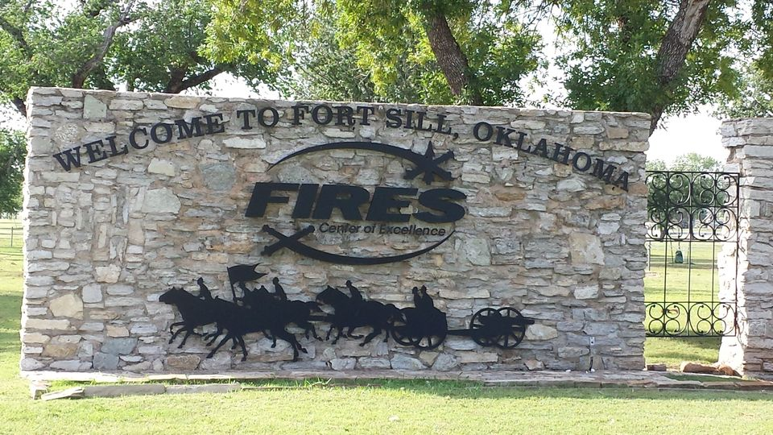
Fort Sill’s Economy
Mr. Joe Gallagher
Deputy to Commanding General Fort Sill

Slide 41
FY2012-15 Fort Sill Impact on the Local Economy
$ In Millions
Since Fiscal Year 2012:
13.8% DECREASE in Overall Economic Impact
9.1% DECREASE in Appropriated Funds Expenditures
84% DECREASE in Military Construction Project Spending
Total decrease in economic impact since FY12 $607M

Slide 42
Fort Sill Manning FY11-15
Military Manning-
Continuing decrease since FY12 (18.4%)
Cumulative loss of
1207 Military &
588 Civilians
Civilian Manning-
Continuing decrease since
FY11 (18.9%)
Does not include the addition of 2-20 & 5-5 or the Enterprise Partner cuts (~+400)

Slide 43
LEDC Mission, Initiatives, and Metrics
Mr. Phil Kennedy
Chairman Lawton Economic Development Corporation

Slide 44
Lawton – Fort Sill Economic Development Corporation
The Corporation’s goal is to strengthen regional employment, build a base of high-value industries, and significantly improve the economic future for all who live and work in the region.
The Corporation’s mission is to drive and ensure economic growth by recruiting and creating high-quality jobs to the Lawton area. This includes attracting new capital investment, retaining and expanding existing businesses and industries with a focus on high technology industries.

Slide 45
Lawton – Fort Sill Economic Development Corporation
Initiatives
1) Establish the Lawton-Fort Sill Economic Development Corporation as the “one-stop” agency for all economic development services in the greater Lawton region.
2) Recruit targeted industries/businesses and work to diversify Lawton’s economic base while preserving the core industry base.
3) Design and develop new tools and strategies to enhance the community’s economic development image.
4) Develop the community’s capacity for new and sustained economic growth.
5) Globally escalate the awareness of Lawton’s education assets and capabilities.
6) Identify issues that may limit our economic development and coordinate with community organizations to eliminate those issues.
7) Develop processes of communication and education of economic development.
8) Support efforts to ensure there is adequate quality and quantity of workforce to meet employer needs.

Slide 46
Where does the money come from?
City of Lawton
Hotel/Motel Tax
70%
Chamber
30%
City of Lawton
Approximately
$700,000
in this fund
$267,075
Tourism + $42,500
Event Revenue
$300,000
LEDC
11% Economic
Development
14%
Tourism
$65,643
Econ Dev + $200,0000
Private Contributions
$100,000
Private Contributions
5%
Lawton Beautiful
$77,537
Govt/Military Affairs +
$18,000 Event Revenue
CCIDA
$2,500,000 in fund
$700,000/year
1/8 cent
County Sales Tax
$76,125
Shared Admin
Expenses

Slide 47
Lawton – Fort Sill Economic Development Corporation
2016 Anticipated Income/Staffing
Income
Hotel/Motel Tax $300,000
Private Contributions $100,000
Total $400,000
Staff
Interim President Tom Thomas EdD.
Administrative Assistant Inga Wells

Slide 48
Lawton – Fort Sill Economic Development Corporation
Contract Metrics
Performance Measure | Annual Target
New Primary Jobs | 200
Average Salary of new jobs | $40,000
Capital Investment | $16.4 M
Increase Tax Base | $3.3M
Entrepreneurship | 10 New Products/Services
Recruitment | 24 Leads, 100 Prospects
Lead Development | Contact 75 National Site Consultants, 20 Corporations
Marketing | 15% Increase in Social Media and Website Visitors
Public Relations | 12 National Media Stories
Outcomes
Activities

Slide 49
Lawton – Fort Sill Economic Development Corporation
Performance Metrics
Performance Measure | Annual Target | 2014 Performance | 2015 Performance
New Primary Jobs | 200 | 616 | 776
Average Salary of new jobs | $40,000 | $43,726 | $34,536
Capital Investment | $16.4 M | $21.6 M | $66.9 M
Increase Tax Base | $3.3M | $28 M | $93.7 M

Slide 50
Reality Check
Thoughts on Economic Development
Dr. Tom Thomas
Interim President LEDC

Slide 51
Economic developers promote economic well-being and quality of life for their communities, by creating, retaining and expanding jobs that facilitate growth, enhance wealth and provide a stable tax base.
International Economic Development Council

Slide 52
Job Creation -vs- Wealth Creation
Although any job someone wants is probably a benefit to the community, all jobs do not provide the opportunity to create wealth.
What is the average wage in Comanche County? $34,025 (Private Sector 2015)
What is a living wage in Comanche County? $47,275 ($22.37/hr, 2 adults, 1 working, 2 children)
(Source: MIT) $56,863 ($13.67/hr, 2 adults working, 2 children)
What is the Quality Jobs threshold for $41,861
Comanche County?
What is LEDC target wage for jobs added? $40,000 (111% of MSA wage)
What has been the average wage of LEDC jobs added?
2014 $43,726
2015 $34,536
How much “control” do we actually have over wages paid?

Slide 53

$13.67/hr @
$22.73/hr
2 Adults, both Working, 2 Children
2 Adults, 1 Working, 2 Children
$9.97/hr
1 Adult
(Private Sector
Only)
(111% of MSA Average)
Public + Private

Slide 54
Job Creation -vs- Wealth Creation
Where do the $$ come from to make the payroll? Does it matter?
State Employees
State Budget
Federal Employees
Federal Budget
PVT Sector Goods and Services
Customers world-wide
PVT Sector Goods and Services
Customers in-county

Slide 55
Job Creation -vs- Wealth Creation
Which of these sectors can we hope to truly impact?
State Employees
State Budget
Federal Employees
Federal Budget
PVT Sector Goods and Services
Customers world-wide
PVT Sector Goods and Services
Customers in-county

Slide 56
Job Creation -vs- Wealth Creation
Which of these sectors can create the greatest amount of wealth?
Where does the “profit” go? Does it matter?
State Employees
State Budget
Federal Employees
Federal Budget
PVT Sector Goods and Services
Customers world-wide
PVT Sector Goods and Services
Customers in-county
Within these two sectors, where are we doing the best in wages -vs- Oklahoma and the US?

Slide 57
56.38%
% represents County Wage as % of State Wage
Source: OESC - QCEW
92.46%
117.69%
65.38%
67.35%
83.65%
78.23%
71.80%
67.81%
80.68%
76.86%
88.46%

Slide 58
52.45%
% represents County Wage as % of State Wage
Source: OESC – QCEW
Green Indicates Gain Over 2014, Red Loss, Purple % of US
122.37%
102.36%
94.36%
74.65%
72.00%
81.84%
72.89%
70.20%
79.28%
72.50%
75.90%
84.00%

Slide 59
What is our niche?
What can we do better than anyone else?
What is unique about Comanche County that can impact businesses?
Fort Sill
Wichita Mountains/Wildlife Refuge
Others?

Slide 60
What is our niche?
What are our competitive advantages?
Strong Manufacturing Presence (Cluster)
Proximity to Dallas-Fort Worth
Mild Climate
Relatively Cheap Utilities
Relatively Cheap Land
Former Indian Land (Accelerated depreciation allowance)
Opportunity Zones (Lowers QJP requirements)
Non-Union Environment
Wages?? (Double-edge sword)
Quality of Workforce (What community doesn’t say this?)
Strong training support
CETES and Great Plains Business Center (Incubators)
Regional Economic Modeling Software (REMI)
Others?
How can we make the best of these advantages? Have we?

Slide 61
What are our competitive disadvantages?
Limited incentive fund $ available (compared to some others)
Limited labor force? (Significant under-employment)
Limited industrial land
Limited utilities available at the west side industrial park
Lack of rail service to CCIDA/LEDC owned property
3 of 3 manufacturing RFP’s from ODOC required rail
Very few suitable buildings available, esp. manufacturing
3 of last 4 RFP’s from ODOC were looking for existing facilities
No SPEC or shell buildings available
Others?
“Available buildings are still really important, but importance of available land seems to have gone down in priority. There are more spec buildings available in many markets (higher point in market cycle…spec is back) — and more options for existing core/shell buildings. Thus, many companies — especially those in higher skilled industries/operations — are focusing less on peripheral locations, so they’re less concerned about land and more concerned about available buildings. Fewer companies are buying land and doing development of their own facility. With time to market being critical, it’s easier to get up and running if you can build out a spec instead of engaging in a ground-up development process.”
Source: Area Development -- Executive Survey Summary

Slide 62

Economic Development is about
both sides of the coin
Business
Retention &
Expansion
Business
Recruitment
The issue is balancing these activities,
finding time for both

Slide 63
Business Retention and Expansion
The best way for LEDC to help your business expand is to make your needs known to the organization. Some manufacturers do this on a regular basis.
LEDC has limited resources to assist retail businesses or to help expand the market of most businesses. The Chamber is a better resource for this. (Retail Coach)
Cameron and Great Plains offer significant resources to assist most businesses on operational issues. LEDC needs to focus limited resources on business expansions or significant technology upgrades.

Slide 64

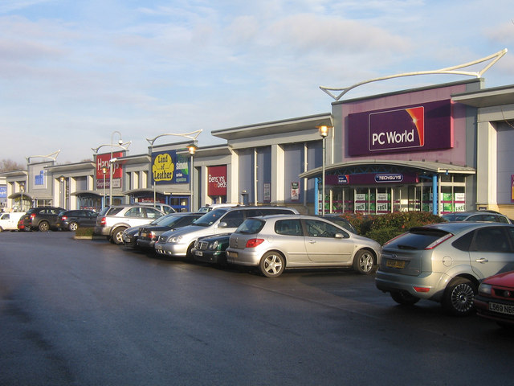
What is NOT a main focus of LEDC?

Slide 65

So what about Business Recruitment?
How does that work?

Slide 66
What companies create jobs?
Small -vs- Large -vs- Young? “The younger companies are, the more jobs they create, regardless of size.” (National Bureau of Economic Research) Speaks to the importance of Entrepreneurial support and Incubators.
Number of Communities competing for jobs is very large, over 10,000…Why Lawton?
How does LEDC get leads?
Trade Shows
Call Trips (ODOC and other)
ODOC RFI/RFP (Pre-Qualified)
In-coming inquiries
Referrals (local and other)

Slide 67

What is the role of incentive $ in our work?
Some deals come down to what a community will offer as the tie-breaker between competing communities.
Incentives will never make a bad deal a good deal for either the community or the company. Location decisions must make business sense regardless of what is offered.
If our competition is out-of-state, Oklahoma state incentives will play a very large role as they can be significant.
If our competition is in-state, it could
come down to the difference in the
local incentives offered by competing
communities because the state
incentives should be equal across
the state.

Slide 68
Major Oklahoma State Incentive Programs
(There are many – 77 page guide)
Quality Jobs Program – Rebate of a portion of newly created payroll for qualifying companies. Cash payments, maximum 5% for 10 years. (6% if 10% of workforce is former military.) Also, Small Employer QJP and 21st Century QJP.
Example: $10M payroll, $500K/year, $5M total possible
Ad Valorem Exemption – Qualifying companies exempt from property tax for 5 years. Developed for manufacturers, extended to others. Windfarms claim the bulk of this incentive. State is supposed to reimburse schools, tech centers and counties but the legislature never appropriates enough funds to do so.
Various Tax Exemption Programs
Various ED and Infrastructure funding programs available for certain projects.
Workforce assistance and Employee Training programs (TIP, GPTC)
Multiple other incentive programs for specific purposes.

Slide 69
What type of local incentives can/ do we offer?
Type of Incentive | Organization Responsible | Potential Issues | Used Previously
Free or Inexpensive Land for Jobs | CCIDA/LEDC | Limited Availability | X
Build to Suit Opportunities | CCIDA/LEDC | Limited Funding Available
Site Preparation | CCIDA/LEDC | Limited Funding Available | X
Environmental -- Phase 1 & 2 | CCIDA/LEDC | Limited Funding Available
Low Interest or Forgivable Loans | CCIDA/LEDC | Limited Funding Available | X
Relocation Assistance | CCIDA/LEDC | Limited Funding Available
Sales Tax Forgiveness | City
CDBG Infrastructure Grants | City
City Permitting Discounts | City
Utility Hookup Fee Waivers/Discount Rates | City
Cash through City General Fund/Sales Tax | City | Sales Tax Generators Only? | X
Tax Increment Financing | City/County | Time Delay, Limited Application | X
Property Tax Forgiveness | County | Lack of Mechanism?
Workforce Training Assistance | GPTC/Cameron/ASCOG | Limited/No TIP Funding | X
Real Estate Assistance | LEDC |  | X
EDA Grants | LEDC/ASCOG | Time Delay, No Relocations
Workforce Hiring Assistance | LEDC/GPTC/City/OESC |  | X
Access Road Improvements | ODOT/City/County | Time Delay
Tribal Partnerships ($ and Workforce) | Tribes | Little Groundwork Laid
Spec Buildings for Lease or Sale |  | Funding
Industrial Development Bonds
Mortgage Points Discounts
Drug Testing Assistance
Temporary Office Space |  | GPTC has Provided; GY, Canadair, Assurant, Hilton, Target and others | X
Country Club Memberships for Executives

Slide 70

How much local incentive $ do we have available?
LEDC Property Only
< 20 acres in West Industrial Park
50 acres in Airport Industrial Park
City $700,000 in ED Fund
CCIDA $2.5M Balance Available
$700+K Annual Income (1/8 cent tax)
480 Acres (West Industrial Park – Utilities Issue)
What type of “deals” should we try to incent? How do we determine what a deal is worth? (REMI)
What can LEDC “promise”?
Should we try to offset a
marginal business decision
with incentive $?

Slide 71
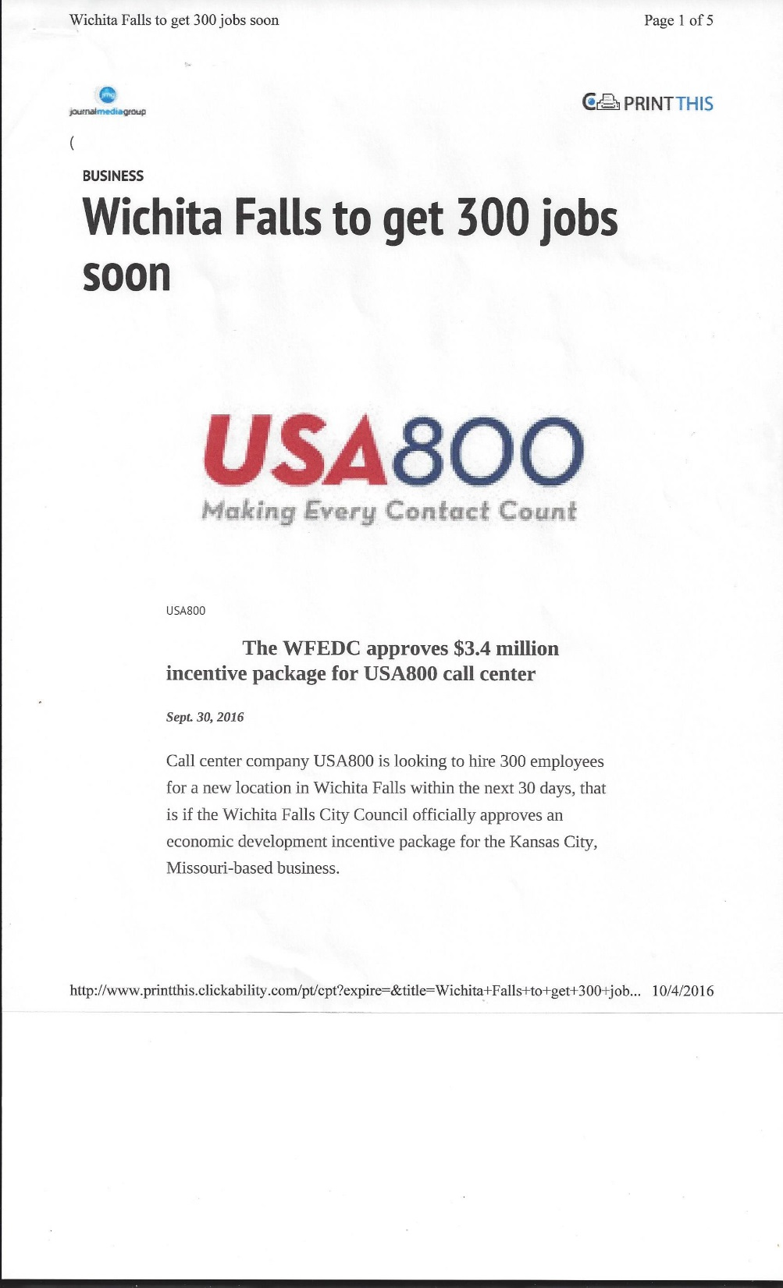
An Example of a Recent Deal…
*Existing Facility
*Call Center
*300 jobs (600 possible)
*$3.4M Incentive
$2.6 M cash-for-jobs
$800K training
*ESOP company
*The call center will be located in the old WDS call center. WDS also received an incentive package worth $3.6 million dollars, stayed in town for five years and closed in 2015.

Slide 72
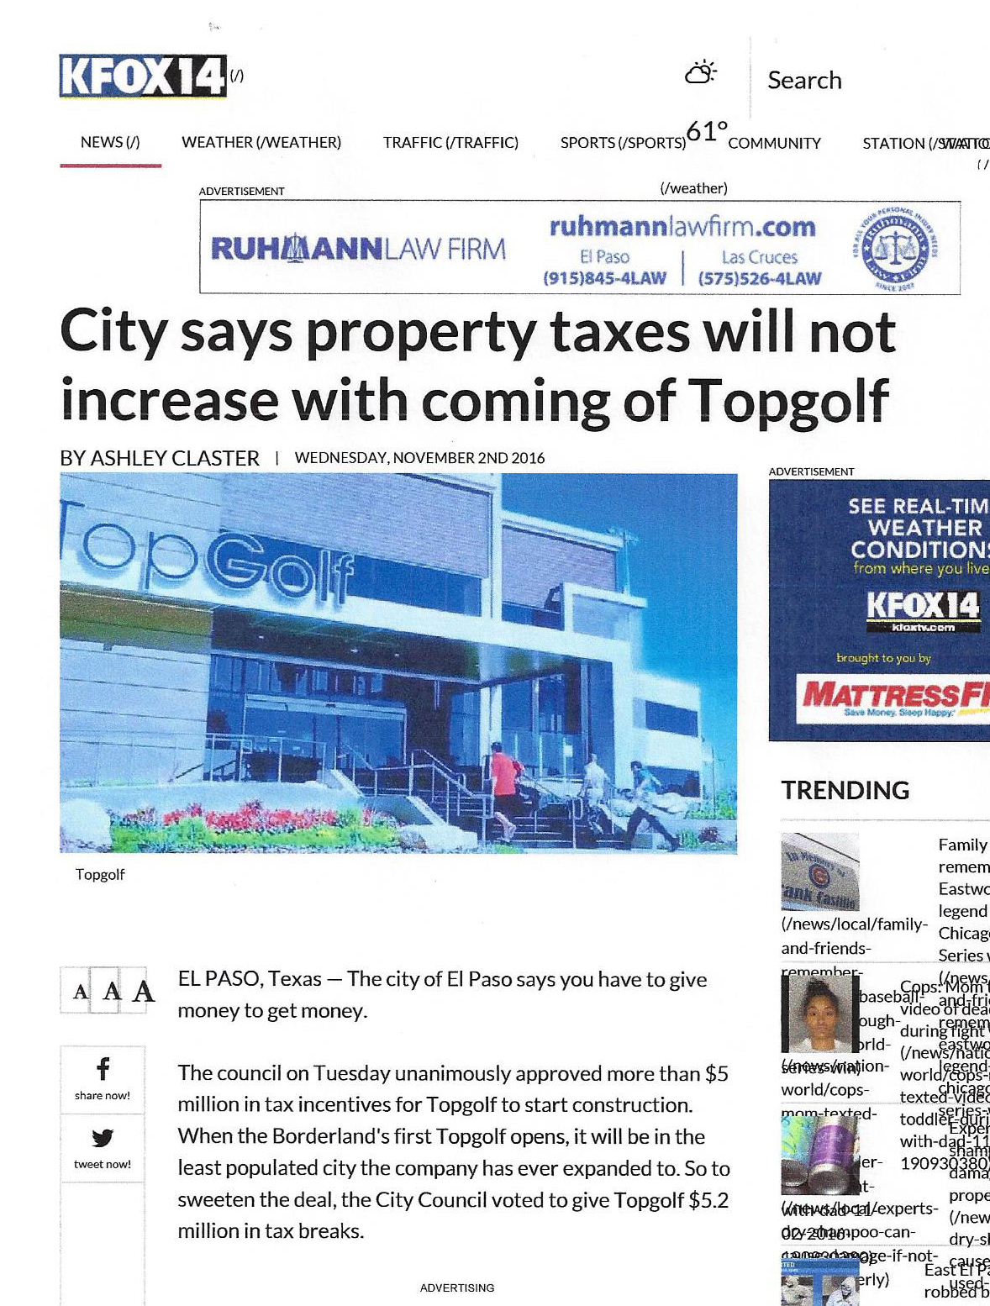

Slide 73

So…What’s our chances?
How often can we expect a deal?

Slide 74
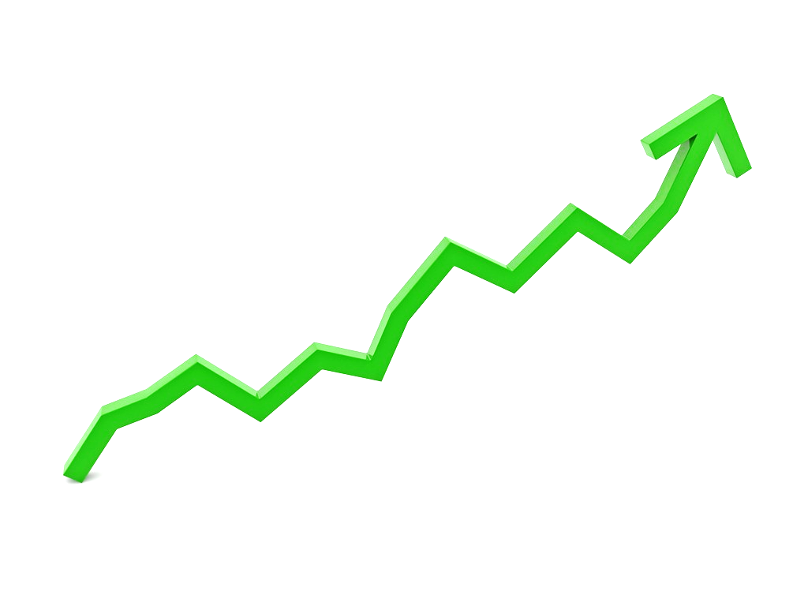
Locations and Expansions in
Oklahoma 2014
In 2014, 120 Companies announced new locations or expansions in the state creating 13,000 new direct jobs with an investment in excess of $4B.
Of this 120, more than 100 were expansions of companies already in the state. The remaining were new locations of companies not already here.
Source: Expansion Solutions Magazine, verified by Oklahoma Department of Commerce

Slide 75
Locations and Expansions in
Oklahoma 2015
In 2015, approximately 75 Companies announced new locations or expansions in the state creating 5,000 new direct jobs with an investment in excess of $2.5B
Of this 75, about 80% (60) were expansions of companies already in the state. The remaining were new locations of companies not already here.
Source: Oklahoma Department of Commerce

Slide 76
Locations and Expansions* in Oklahoma
# Projects not already In Oklahoma
# Jobs in all projects
Investment in all Projects in Billion $
*Projects worked by ODOC

Slide 77
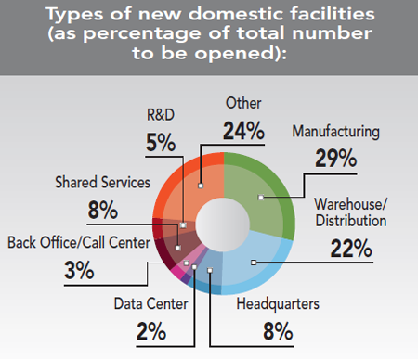
How many deals are out there and what are the most important considerations for a company that wants to expand or relocate to a different community?
Source: Area Development, 2015 Corporate Executive Survey (30th Annual Survey)
14% report interest in the southwest: Arizona, New Mexico, Oklahoma and Texas
Do we have location issues?

Slide 78
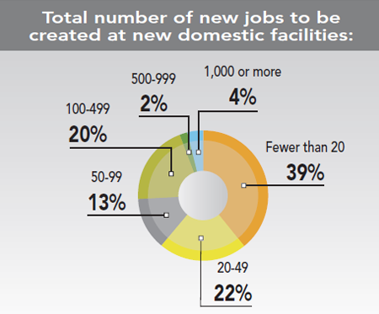
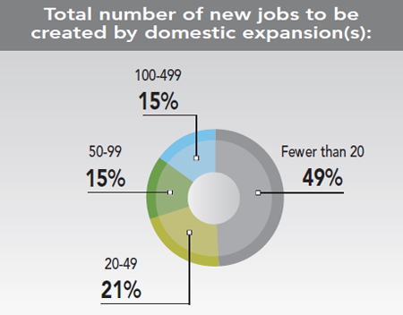
We are all hunting for the whales!
But how many whales are out there?
Source: Area Development, 2015 Corporate Executive Survey

Slide 79
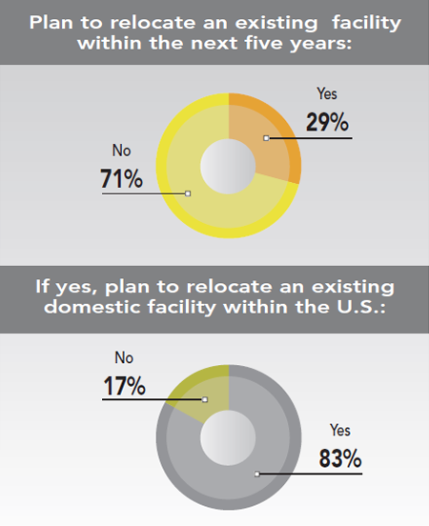

Source: Area Development, 2015 Corporate Executive Survey

Slide 80
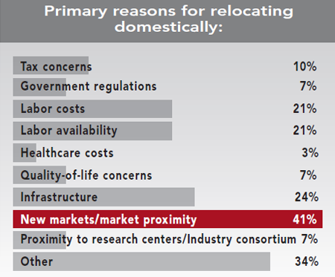

DFW?
Source: Area Development, 2015 Corporate Executive Survey

Slide 81
Ranking of Site Selection Factors
Combined Ratings Corporate Survey 2015*
Rank | Site Selection Factors | 2015 | 2014**
1 | Availability of skilled labor | 92.9 | 82.1 (5)
2 | Highway accessibility | 88.0 | 88.3 (1)
3 | Quality of life | 87.6 | N/A
4 | Occupancy or construction costs | 85.4 | 87.9 (2)
5 | Available buildings | 83.7 | 82.2 (4)
6 | Labor costs | 80.8 | 81.6 (6)
7 | Corporate tax rate | 78.8 | 75.6 (10)
8 | Proximity to major markets | 76.3 | 77.1 (8)
9 | State and local incentives | 75.8 | 73.2 (11)
10 | Energy availability and costs | 75.3 | 76.8 (9)
11 | Tax exemptions | 74.7 | 73.2 (11T)
12 | Expedited or "fast-track" permitting | 74.2 | 71.0 (13)
13 | Available land | 73.9 | 85.7 (3)
14 | Environmental regulations | 69.8 | 86.6 (16)
*All figures are percentages and are the total of the "very important" and "important" ratings of the Area Development Corporate Survey and are rounded to the nearest tenth of a percent.
**2014 ranking

Slide 82
Ranking of Site Selection Factors
Combined Ratings Corporate Survey 2015*
Rank | Site Selection Factors | 2015 | 2014**
15 | Training programs/technical colleges | 68.7 | 62.8 (18)
16 | Availability of long-term financing | 67..7 | 63.1 (17)
16T | Right-to-work state | 67.7 | 77.9 (7)
18 | Low union profile | 66.3 | 70.9 (14)
19 | Inbound/outbound shipping costs | 64.6 | 69.5 (15)
20 | Proximity to suppliers | 64.3 | 60.3 (21)
21 | Accessibility to a major airport | 58.6 | 62.4 (19)
22 | Water availability | 54.6 | 44.0 (25)
23 | Availability of advanced ICT services | 53.6 | 45.1 (24)
24 | Raw materials availability | 52.6 | 53.7 (22)
25 | Proximity to innovation/commercialization R&D centers | 48.4 | N/A
26 | Availability of unskilled labor | 47.8 | 52.5 (23)
27 | Railroad Service | 32.4 | 30.9 (26)
28 | Waterway or oceanport accessibility | 24.0 | 27.8 (27)
*All figures are percentages and are the total of the "very important" and "important" ratings of the Area Development Corporate Survey and are rounded to the nearest tenth of a percent. **2014 ranking

Slide 83
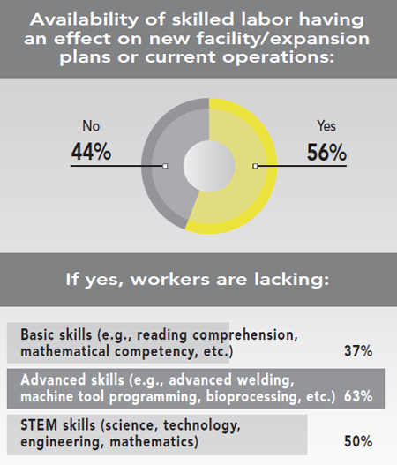

Source: Area Development, 2015 Corporate Executive Survey

Slide 84
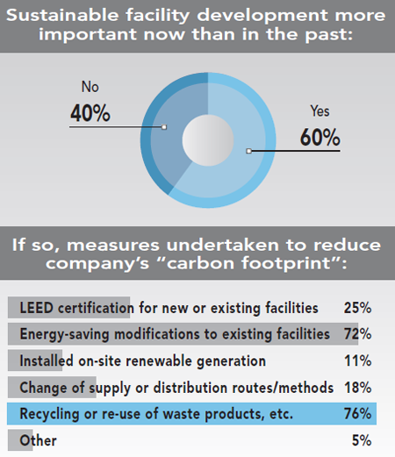

Source: Area Development, 2015 Corporate Executive Survey

Slide 85
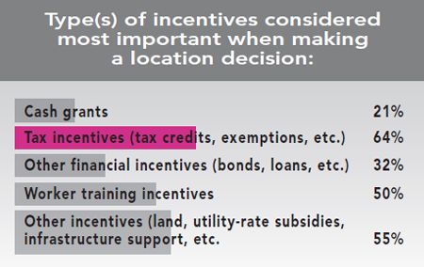

Source: Area Development, 2015 Corporate Executive Survey

Slide 86
2017 State Business Tax Climate Index
Based on the results of the Tax Foundation’s latest ranking, the following 10 states have been identified to have the best overall business tax climate:
  Wyoming
  South Dakota
  Alaska
  Florida
  Nevada
  Montana
  New Hampshire
  Indiana
  Utah
  Oregon

Slide 87
2017 State Business Tax Climate Index
How did Oklahoma fare?
Overall Tax Rate 31st
Corporate Tax Rate 9th
Property Tax Rate 12th
Individual Income Tax Rate 38th
Sales Tax Rate 36th
Unemployment Insurance Tax Rate 1st
Source: Tax Foundation

Slide 88
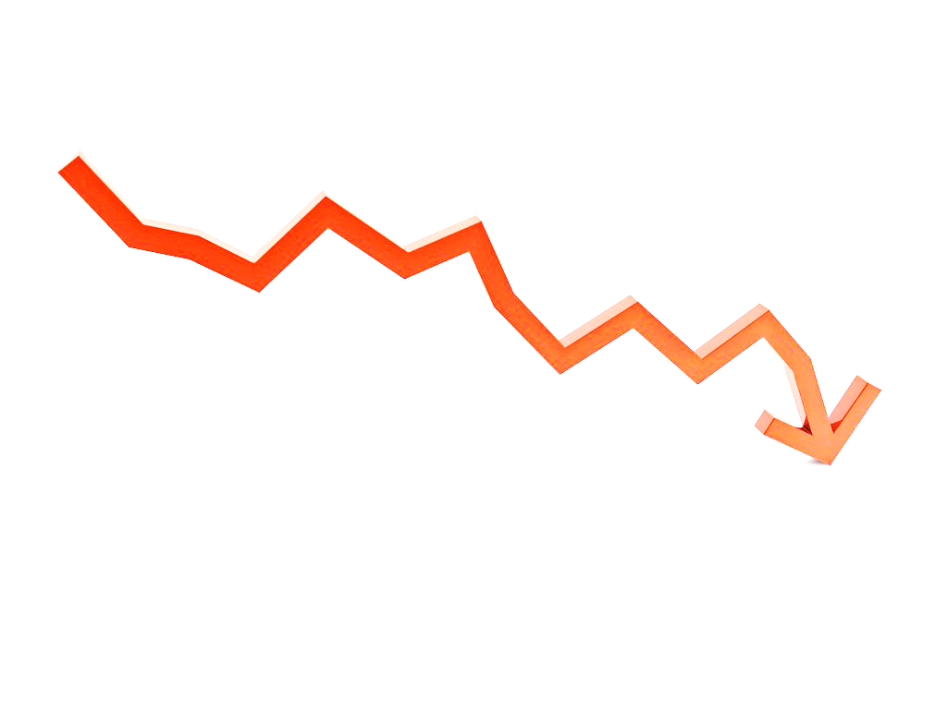
If we are doing well, why aren’t Sales Tax Collections going up?
1) New jobs reported by LEDC are not net gains if other jobs are lost in the community
2) Effects of growing E-Commerce??

Slide 89
Between the end of 2009 and this July e-commerce doubled its share of the retail pie and while overall sales have risen a cumulative 31 percent, department store sales have plunged 17 percent, according to Commerce Department data.
According to Howard Davidowitz, chairman of Davidowitz & Associates Inc, which has provided consulting and investment banking services for the retail industry since 1981, half the 1,100 U.S. regional malls will close over the next decade.

Slide 90
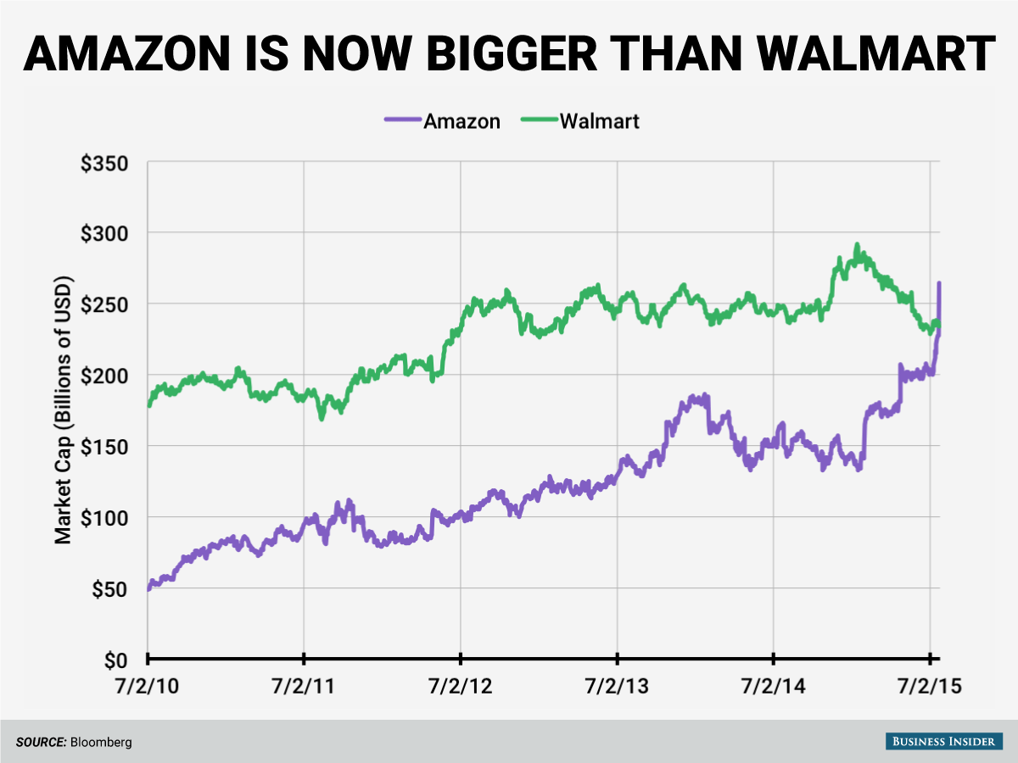

Slide 91
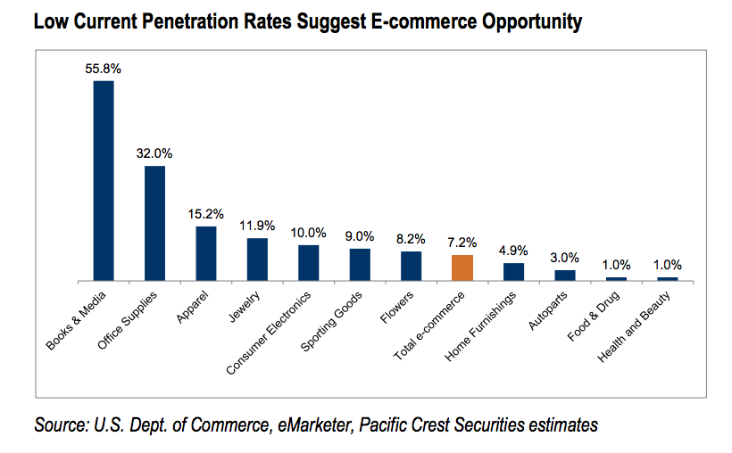
$7.20 of every $100 spent

Slide 92
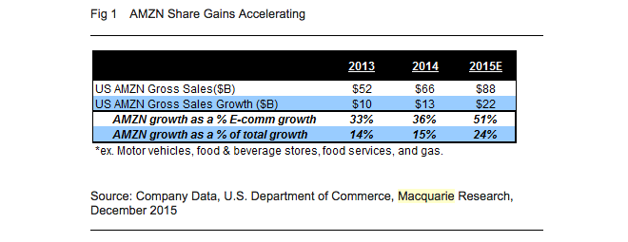

Slide 93
Economic Uncertainty Persists for OKC
Russell Evans, Meinders School of Business, OCU
August 22nd, 2016
“OKC continues to grow at a pace greater than all but six of the metro areas among the 31 with 2 million or more residents, a group OKC is expected to join by midcentury.”
“It’s still the case that OKC’s population growth, our jobs growth, is still far outpacing national averages and national trends.”
“Private employment is growing at a 1.1% annual rate and weekly wages have been on the increase for three months.”
“It is hard to reconcile some of those positives in the indicators of underlying economic activity in OKC with greater-than-expected sales tax declines.”

Slide 94
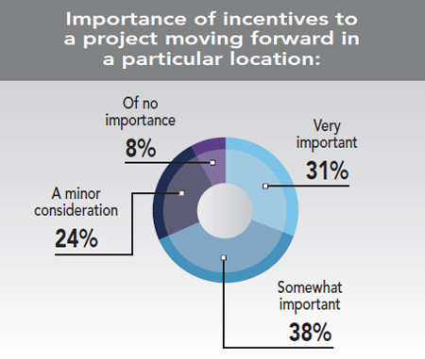

69%
Source: Area Development, 2015 Corporate Executive Survey

Slide 95
Q3 2016 Incentive Packages Offered in US
Deals Offered 456
Total $ offered $1.81 B
Expected capital investment $15 B
New jobs 72,400
Average $ per job $25,030
Average incentive value $3.9 M*
Median incentive value $750 K
*Heavily skewed by small number of very large packages offered.
Source: Site Selection Group

Slide 96
Q3 2016 Incentive Packages Offered in US
Number of Projects by Incentive Value
Largest was Walt Disney World Hotel in Anaheim Ca. $267M, 1,150 jobs
($232,173/job)
Source: Site Selection Group

Slide 97
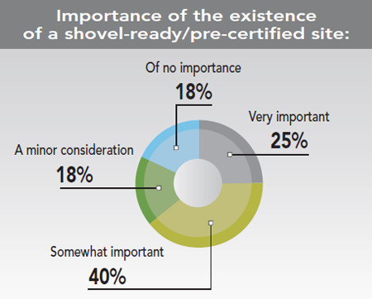
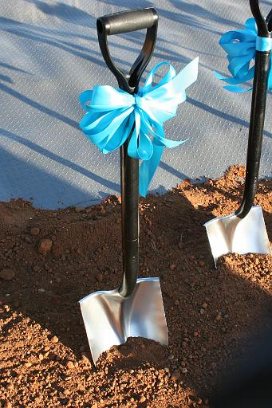
Source: Area Development, 2015 Corporate Executive Survey

Slide 98
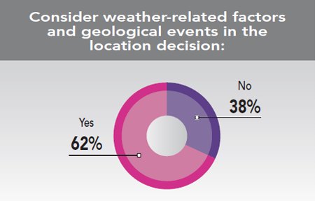
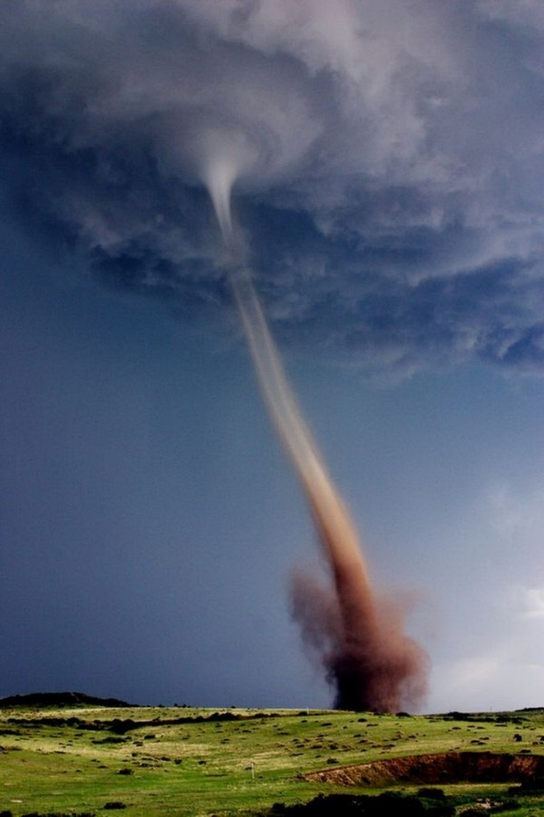
Source: Area Development, 2015 Corporate Executive Survey

Slide 99

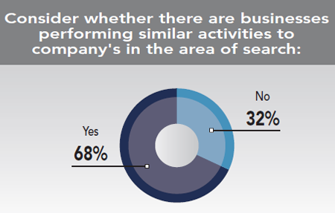

Source: Area Development, 2015 Corporate Executive Survey

Slide 100
Best States for Manufacturing
Ranking Criteria | Weighting
Labor availability | 35%
Logistics | 15%
Tax climate | 15%
Utility costs | 15%
Labor costs | 15%
Union climate | 5%
Source: Site Selection Group, Oct 24, 2016

Slide 101
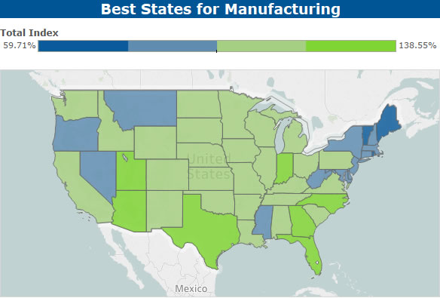
Source: Site Selection Group, Oct 24, 2016

Slide 102
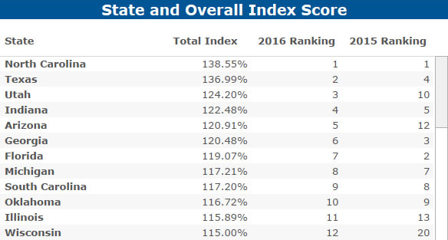
Best States for Manufacturing
Source: Site Selection Group, Oct 24, 2016

Slide 103
One other thought – There is always going to be a natural tension between existing businesses and “new” jobs brought about by recruitment or expansion as lower paid employees migrate to better paying jobs or jobs with better benefits. The more successful we are, the greater the tension can become….especially for employers with underemployed staff. We need to be aware of this and mindful of the impact this can have on local employers.

Slide 104
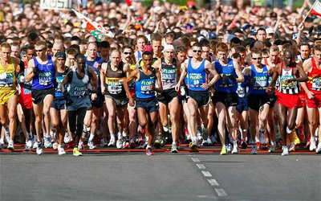
Economic Development is a long game…it often takes years to build the relationships needed to land a deal. It is a marathon, not a sprint.

Slide 105
Wrap-Up and Questions
Mr. Mark Brace
Mr. Phil Kennedy

Slide 106

Questions,
Thoughts,
Ideas, Leads?

